Slide 1
Indian Constitution
UNIT –I
TOPICS COVERED:
Salient Features of Indian Constitution
Preamble of India Constitution and key concepts f the preamble
Fundamental Rights (FR’s)
By:
Ganashree K C
Assistant Professor
Department Of CSE
RV College of Engineering

Slide 2
Indian Constitution
The Constitution of India is a very dynamic creation of our lawmakers.
The Constitution of India as we all know is a supreme law of the country and every citizen of our country has to abide by the constitution.
The Lengthiest Constitution of the World
- There are 12 schedules and 448 articles in our Constitution
- The parent document for drafting the Indian Constitution was the Government of India Act 1935.
Establishment of a Sovereign, Socialist, Secular, Democratic Republic
Parliamentary form of Government
A unique blend of rigidity and flexibility
Fundamental Rights
Directive Principles of State Policy
A Federation with a strong centralising tendency
Adult suffrage
An Independent Judiciary
A Secular State
Single Citizenship
Fundamental Duties
Judicial Review

Slide 3
https://www.youtube.com/watch?v=0U9KDQnIsNk
https://www.youtube.com/watch?v=TVz6qKbYBmE
https://www.youtube.com/watch?v=hQB-yXb4NN4

Slide 4
Preamble to the Constitution of India
A preamble is an introductory statement in a document that explains the document’s philosophy and objectives
It presents the intention of its framers, the history behind its creation, and the core values and principles of the nation.
The Preamble to Constitution of India is guidelines to guide people of the nation, to present the principles of the Constitution, to indicate the source from which the document derives its authority, and meaning.
The preamble can be referred to as the preface which highlights the entire Constitution.
It was adopted on 26 November 1949 by the Constituent Assembly and came into effect on 26 January 1950, celebrated as the Republic day in India. Preamble was made in 1947 but adopted in 1949.

Slide 5
The Preamble reads:
WE, THE PEOPLE OF INDIA, having solemnly resolved to constitute India into a SOVEREIGN SOCIALIST SECULAR DEMOCRATIC REPUBLIC and to secure to all its citizens:
JUSTICE, social, economic and political;
LIBERTY of thought, expression, belief, faith and worship;
EQUALITY of status and of opportunity;
and to promote among them all
FRATERNITY assuring the dignity of the individual and the unity and integrity of the Nation;
IN OUR CONSTITUENT ASSEMBLY this twenty-sixth day of November, 1949, DO HEREBY ADOPT, ENACT AND GIVE TO OURSELVES THIS CONSTITUTION.

Slide 6
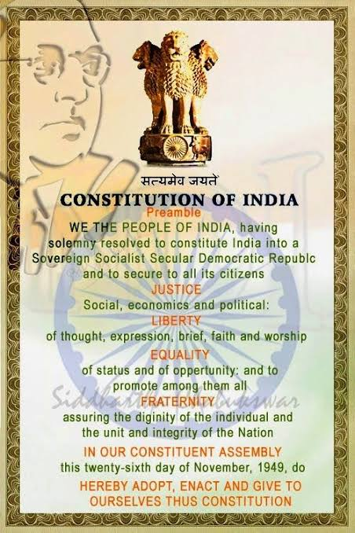

Slide 7
Fundamental Rights:
Fundamental rights in India are the rights guaranteed under Part III (Articles 12-35) of the Constitution of India.
There are six fundamental rights (Article 12 - 35) recognized by the Indian constitution :
the right to equality (Articles 14-18)
the right to freedom (Articles 19-22),
the right against exploitation (Articles 23-24),
the right to freedom of religion (Articles 25-28)
the cultural and educational rights (Articles 29-30)
the right to constitutional remedies (Article 32 and 226).

Slide 8
Fundamental Rights:
Article 14:
Equality before law :
The State shall not deny to any person equality before the law or the equal protection of the laws within the territory of India Prohibition of discrimination on grounds of religion, race, caste, sex or place of birth
Article 15:
Prohibition of discrimination on grounds of religion, race, caste, sex or place of birth.
(1) The State shall not discriminate against any citizen on grounds only of religion, race, caste, sex, place of birth or any of them

Slide 9
Fundamental Rights:
(2) No citizen shall, on grounds only of religion, race, caste, sex, place of birth or any of them, be subject to any disability, liability, restriction or condition with regard to:
(a) access to shops, public restaurants, hotels and palaces of public entertainment; or
(b) the use of wells, tanks, bathing Ghats, roads and places of public resort maintained wholly or partly out of State funds or dedicated to the use of the general public
(3) Nothing in this article shall prevent the State from making any special provision for women and children
(4) Nothing in this article or in clause ( 2 ) of Article 29 shall prevent the State from making any special provision for the advancement of any socially and educationally backward classes of citizens or for the Scheduled Castes and the Scheduled Tribes

Slide 10
Fundamental Rights:
Article 16:
Equality of opportunity in matters of public employment
There shall be equality of opportunity for all citizens in matters relating to employment or appointment to any office under the State.
(2) No citizen shall, on grounds only of religion, race, caste, sex, descent, place of birth, residence or any of them, be ineligible for, or discriminated against in respect or, any employment or office under the State
(3) Nothing in this article shall prevent Parliament from making any law prescribing, in regard to a class or classes of employment or appointment to an office under the Government of, or any local or other authority within, a State or Union territory, any requirement as to residence within that State or Union territory prior to such employment or appointment.

Slide 11
Fundamental Rights:
(4) Nothing in this article shall prevent the State from making any provision for the reservation of appointments or posts in favour of any backward class of citizens which, in the opinion of the State, is not adequately represented in the services under the State
(5) Nothing in this article shall affect the operation of any law which provides that the incumbent of an office in connection with the affairs of any religious or denominational institution or any member of the governing body thereof shall be a person professing a particular religion or belonging to a particular denomination

Slide 12
Fundamental Rights:
Article 17:
Abolition of Untouchability
Untouchability is abolished and its practice in any form is forbidden The enforcement of any disability arising out of Untouchability shall be an offence punishable in accordance with law
Article 18:
Abolition of titles
No title, not being a military or academic distinction, shall be conferred by the State No citizen of India shall accept any title from any foreign State No person who is not a citizen of India shall, while he holds any office of profit or trust under the State, accept without the consent of the President any title from any foreign State No person holding any office of profit or trust under the State shall, without the consent of the President, accept any present, emolument, or office of any kind from or under any foreign State Right to Freedom

Slide 13
Fundamental Rights:
Article 19:
Protection of certain rights regarding freedom of speech etc.
(1) All citizens shall have the right
(a) to freedom of speech and expression;
(b) to assemble peaceably and without arms;
(c) to form associations or unions;
(d) to move freely throughout the territory of India;
(e) to reside and settle in any part of the territory of India; and
(f) omitted
(g) to practise any profession, or to carry on any occupation, trade or business

Slide 14
Fundamental Rights:
Article 19:
(2) Nothing in sub clause (a) of clause
( 1 ) shall affect the operation of any existing law, or prevent the State from making any law, in so far as such law imposes reasonable restrictions on the exercise of the right conferred by the said sub clause in the interests of the sovereignty and integrity of India, the security of the State, friendly relations with foreign States, public order, decency or morality or in relation to contempt of court, defamation or incitement to an offence

Slide 15
Fundamental Rights:
Article 19:
(3) Nothing in sub clause (b) of the said clause shall affect the operation of any existing law in so far as it imposes, or prevent the State from making any law imposing, in the interests of the sovereignty and integrity of India or public order, reasonable restrictions on the exercise of the right conferred by the said sub clause
(4) Nothing in sub clause (c) of the said clause shall affect the operation of any existing law in so far as it imposes, or prevent the State from making any law imposing, in the interests of the sovereignty and integrity of India or public order or morality, reasonable restrictions on the exercise of the right conferred by the said sub clause

Slide 16
Fundamental Rights:
Article 19:
(5) Nothing in sub clauses (d) and (e) of the said clause shall affect the operation of any existing law in so far as it imposes, or prevent the State from making any law imposing, reasonable restrictions on the exercise of any of the rights conferred by the said sub clauses either in the interests of the general public or for the protection of the interests of any Scheduled Tribe
(6) Nothing in sub clause (g) of the said clause shall affect the operation of any existing law in so far as it imposes, or prevent the State from making any law imposing, in the interests of the general public, reasonable restrictions on the exercise of the right conferred by the said sub clause, and, in particular, nothing in the said sub clause shall affect the operation of any existing law in so far as it relates to, or prevent the State from making any law relating to,
(i) the professional or technical qualifications necessary for practising any profession or carrying on any occupation, trade or business, or
(ii) the carrying on by the State, or by a corporation owned or controlled by the State, of any trade, business, industry or service, whether to the exclusion, complete or partial, of citizens or otherwise

Slide 17
Fundamental Rights:
Article 20:
Protection in respect of conviction for offences
(1) No person shall be convicted of any offence except for violation of the law in force at the time of the commission of the act charged as an offence, nor be subjected to a penalty greater than that which might have been inflicted under the law in force at the time of the commission of the offence
(2) No person shall be prosecuted and punished for the same offence more than once
(3) No person accused of any offence shall be compelled to be a witness against himself

Slide 18
THANK YOU
Q&A

